Slide 1
Marketing Management and Decisions
Pankaj Pradhananga
Kathmandu University School of Management

Slide 2
WHAT IS MARKETING
It is about identifying and meeting human / social needs
Marketing is 'meeting needs profitably'

Slide 3
"Marketing is the activity, set of institutions, and processes for creating, communicating, delivering and exchanging offerings that have value for customers, clients, partners, and society at large"
AMA

Slide 4

"Marketing is a societal process by which individuals and groups obtain what they need and want through creating, offering, and freely exchanging products and services of value with others"

Slide 5
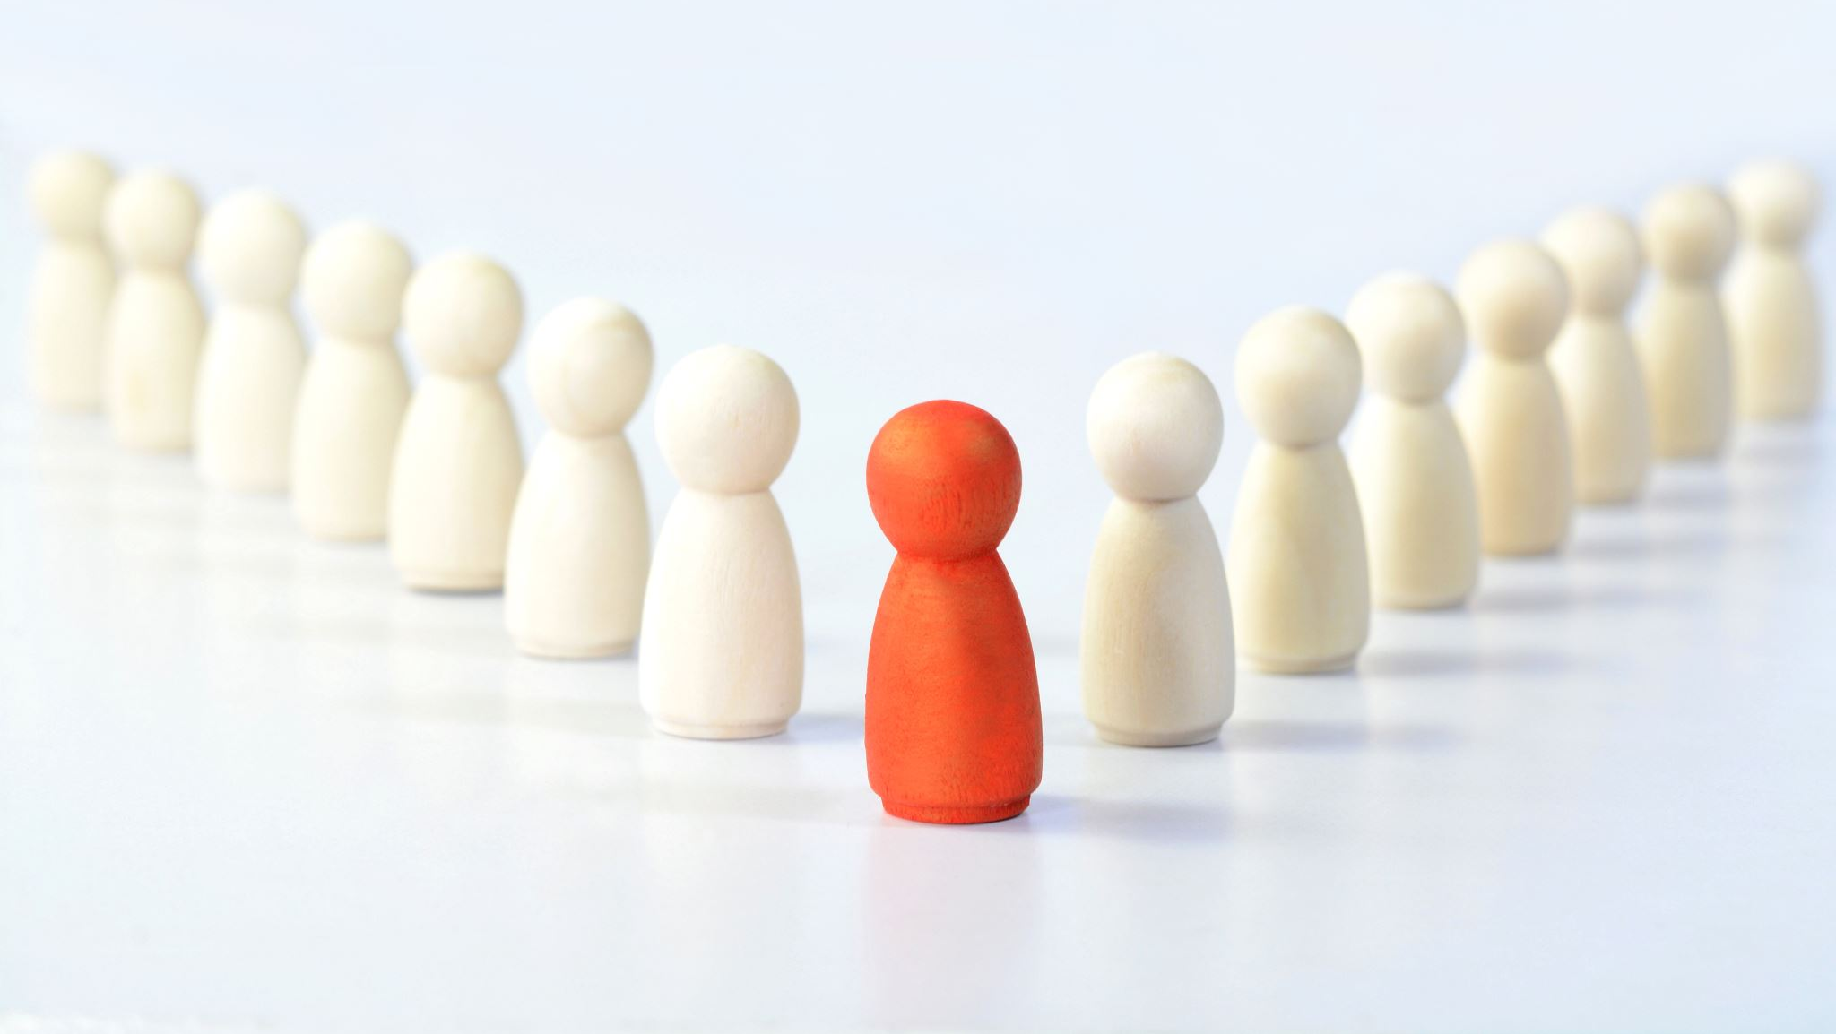
Who is a Marketer ?
Someone who seeks a response – attention, a purchase, a vote, a donation – from another party, called the prospect.
Marketers are skilled at stimulating demand for their products. They also seek to influence the level, timing and composition of demand to meet the organization's objectives.

Slide 6

Market
Marketers view sellers as the industry and use the term MARKET to describe customers group.
Key Customer Markets :
> Consumer markets ( juices, cosmetics, shoes, holidays)
> Business markets
> Global markets
> Nonprofit and Governmental markets

Slide 7
Core Marketing Concepts
Needs
Wants
Demands

Slide 8
Needs
Stated needs
Real needs
Unstated needs
Delight needs
Secret needs

Slide 9
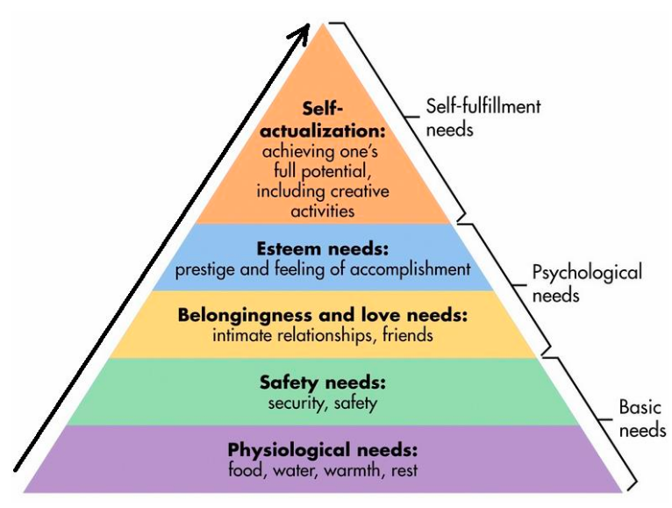

Slide 11
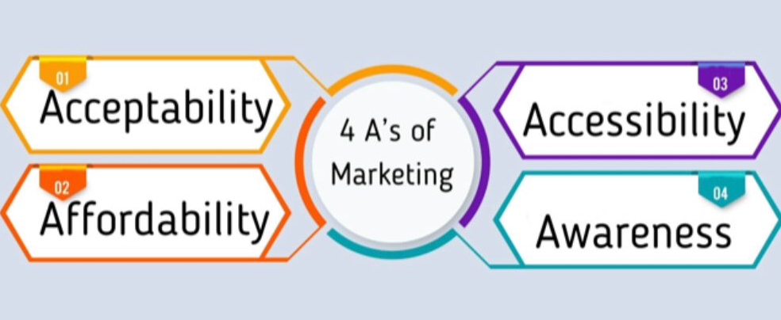
4 A's of Marketing
Acceptability
Affordability
Accessibility
Awareness
Notes:
Accecptability : Functional acceptablity & Psychological acceptablity
Affordability : Economic affodability / psychological affordablity
Accessibility : Customer availability / Customer convenience
Awareness : Product knowledge, brand awareness,

Slide 12
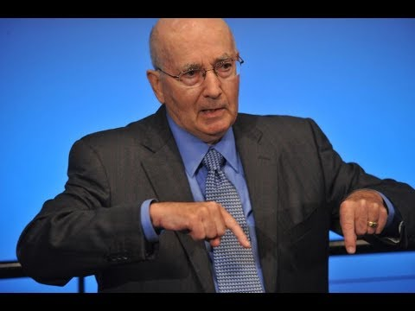
https://www.youtube.com/watch?v=bilOOPuAvTY

Slide 13

CHAPTER 2

Slide 14
Developing Marketing Strategies & Plans
Marketing and Customer Value
Company's success depends upon :
a. fine-tuning the value delivery process
b. Choosing, providing and communicating superior value to well informed customers
The task of any business is to deliver Customer value at a profit.

Slide 15
Value and Satisfaction
The buyer chooses the offerings he or she perceives to deliver the most value, the sum of the tangible and intangible benefits and costs.
Value, a central marketing concept, is primarily a combination of quality, service, and price (QSP), called the customer value triad.
Value perceptions increase with quality and service but decrease with price.
Satisfaction reflects a person’s judgment of a product’s perceived performance in relationship to expectations.
If performance falls short of expectations, the customer is disappointed. If it matches expectations, the customer is satisfied. If it exceeds them, the customer is delighted.

Slide 16
The Value Delivery Process
1. Choosing the value:
The homework marketers do first with formula
STP (Segmentation, targeting, positioning)
2. Providing the Value :
Identify specific product features, price and distribution.
3. Communicating the Value :
Using effective medium internet, advertising, sales force, communication tools to announce and promote the product.

Slide 17
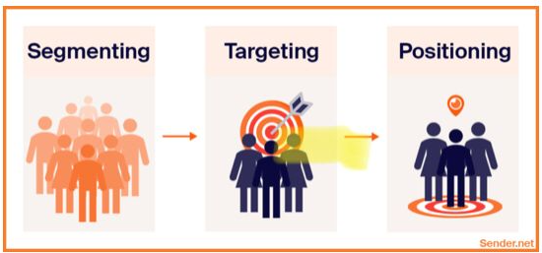

Slide 18
The Value Chain
Michael Porter introduced the value chain as a tool for creating more values for customers.
Nine strategically relevant activities ( 5 primary and 4 supporting) :
Primary : 1. Inbound logistics, brining materials into the business
2. Operations or converting materials into final products
3. Outbound logistics, or shipping out final products.
4. Marketing that includes sales
5. Service.
Support Activities :
1. Procurement
2. Technology development
3. Human Resource management
4. Firm Infrastructure ( cost of general management, planning, finance, accounting, legal and Govt. Affairs)

Slide 19
The core business process :
The market sensing process
The new-offering realisation process
The customer acquisition process
The customer relationship management process
The fulfillment management process

Slide 20
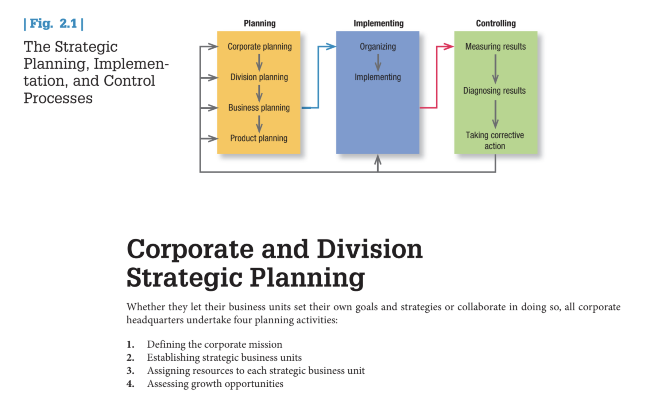

Slide 21
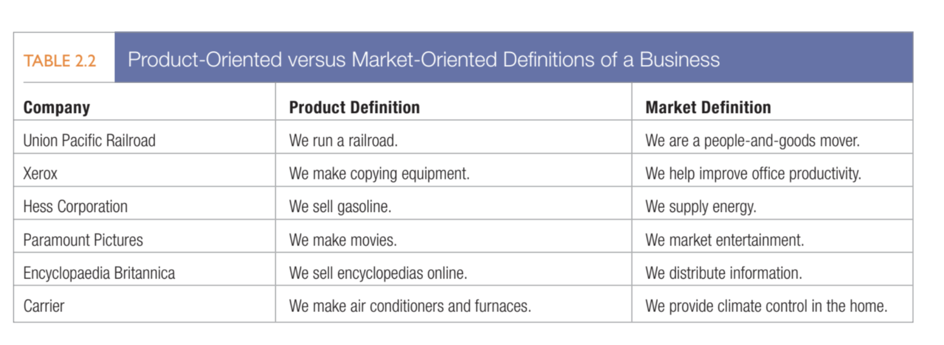

Slide 22
Find Core competencies :
Road house Café
Worldlink
Mediciti
Bhatbhateni
Buddha Air

